Slide 1
National Identity and being a Citizen
Year 8 – Civics and Citizenship

Slide 2
Learning Intentions
Different perspectives about Australia’s national identity, including Aboriginal and Torres Strait Islander perspectives and what it means to be Australian
I can …
Give two examples of Australian values
Explain the meaning of term multi-cultural
Discuss the impact of Aboriginal and Torres Strait Islander peoples after the arrival of Europeans

Slide 3
Democracy and National Identity
Our democratic values reflect the number of shared values of Australians such as:
tolerance
acceptance of cultural diversity
respect of others
the rules of law
freedom of speech, religion and association

Slide 4



What does it mean to be an Australian Citizen?
Think of how you would describe what it means to be Australian to someone from another country.
Discuss your ideas with a neighbour
Get ready to share your discussions
Notes:
This slide asks students to consider the culture and values of Australians.

Slide 5

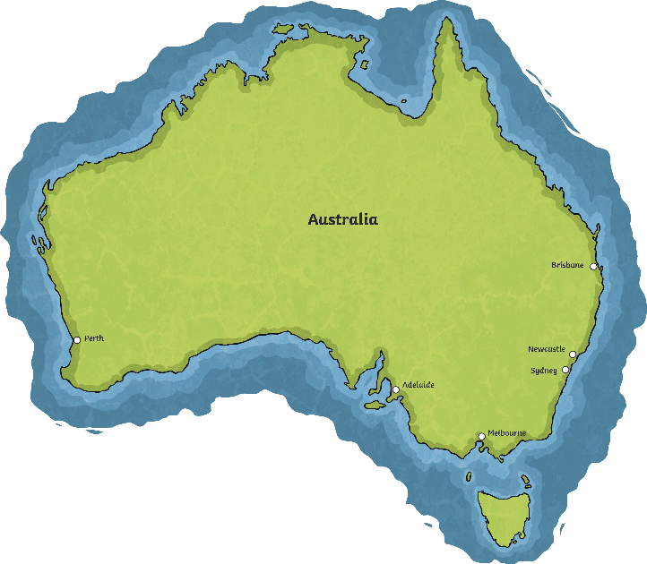
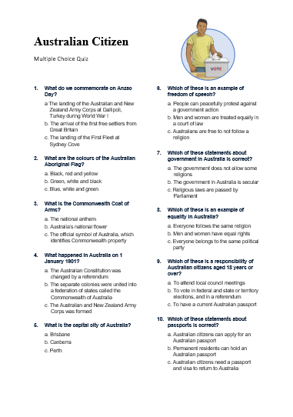
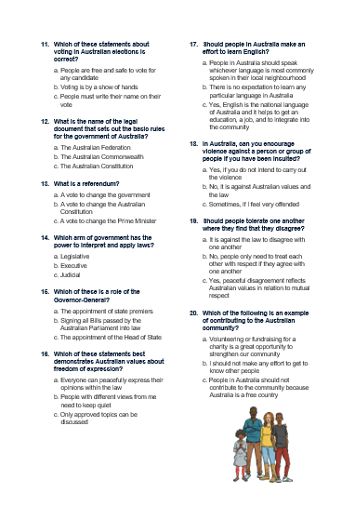
Australian Citizenship
Pre assessment quiz
5 mins

Slide 6

Australian Citizenship Quiz
Swap your quiz with your neighbour.
Mark the quiz
Notes:
Use the Teachers’ marking guide to reveal and discuss the answers

Slide 7

Australian Citizenship Quiz
Would it surprise you to know that the quiz you just did is based on the questions used in the real citizenship test?
Australian citizens are required to work together to make Australia a safe, democratic and inclusive country. Because Australian citizens respect their rights and responsibilities, a harmonious society is created for all.
Do you think this is a fair test? Why / why not?

Slide 8

BTN - Citizenship
Watch this video and find out answers to:
How do you become an Australian citizen?
You were born in Australia, your parents are Australian, you marry an Australian or be naturalised as an Australian
Can you have your citizenship taken away?
You can lose your citizenship if you have dual citizenship and commit a serious illegal act and are then deported. You can also revoke your citizenship to become a citizen of another country where dual citizenship is not permitted.
Notes:
BTN – Citizenship – first broadcast on 19 June 2015
https://www.abc.net.au/btn/classroom/citizenship/10526394
3.15 minutes

Slide 9
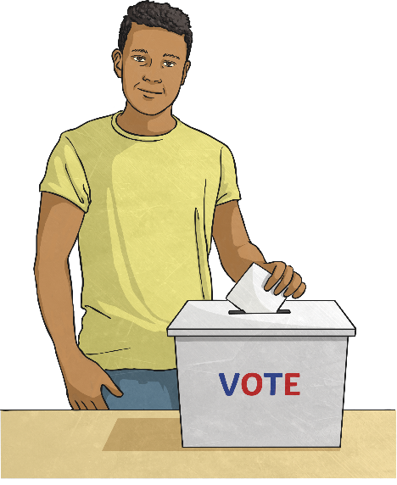
Australian Citizens’ Rights and Responsibilities
Australian citizens have many rights and responsibilities they must live by to ensure Australia is a safe and peaceful place. Can you name some of the rights and responsibilities?
Rights
To feel safe
To speak freely
To be treated fairly and not be discriminated against
Responsibilities
Obey Australian laws
Vote in government elections
Defend Australia if you are called upon to do so

Slide 10
What it means to be an Australian Citizen in a Multi-cultural Society?
Australians come from all over the world and bring may different ideas, cultures and beliefs with them. Australia is regarded as a melting pot of culture.
Having a culturally diverse society means that the government strives to promote and encourage the rights of all Australians.
The aim is for people to express and share their cultural heritage while also respecting the basic structures, such as law, and government, and values of Australia

Slide 11
Aboriginal and Torres Strait Islander people’s perspective of Australian Identity
Aboriginal and Torres Strait Islander people have lived on the Australian continent for more than 60,000 years.
Today , many Aboriginal and Torres Strait Islander people continue to deal with the impact of European settlement.
In particular, assimilation (the process of absorbing one culture into another) is recognised as being very damaging.
Notes:
Discussion the terra nulliuss, dispossession of land, illness and depopulation, stolen generations, assimilation, racism …

Slide 12
The Australian Identity Debate – A Different Lens
As you are watching, think about …
What did you SEE in this video?
What do you THINK about what you saw in this video? What does this video make your WONDER?
What did you LEARN from this story?
How did this story make you FEEL?
What was SURPRISING about this story?
Notes:
YouTube
https://www.youtube.com/watch?v=cZpJQCKaQ5w&t=318s
10.59 minutes

Slide 13
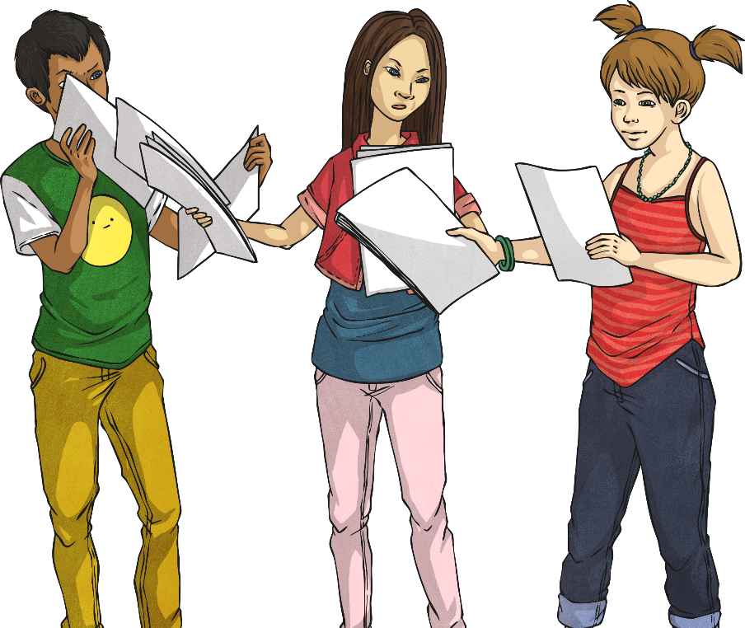
Activity – Diversity Questionnaire
Task: Create a questionnaire that can be used to survey your classmates to investigate the cultural diversity that is represented in our classroom.
Step 1.
Work in pairs to create the questions.
Write your question(s) down and hand the paper in.
Mrs Sargeantson will work with your questions to create a class questionnaire for next lesson.
Notes:
Students could be asked to think about how the believe that their family is diverse and develop a question around their diversity, eg what languages do you speak at home, which country(ies) were your grandparents born in, which country(ies) were your parents born in, where were you born, do you have any family traditions, what celebration food does your family make/eat?

Slide 14
Success Criteria
I can …
Give two examples of Australian values
Explain the meaning of term multi-cultural
Discuss the impact of Aboriginal and Torres Strait Islander peoples after the arrival of Europeans
Different perspectives about Australia’s national identity, including Aboriginal and Torres Strait Islander perspectives and what it means to be Australian

